Slide 1
Literary Criticism and Text Editing MS (Session 2020-2022) by Dr. Faiza Kiran

Slide 2
Lecture : 4

Slide 3
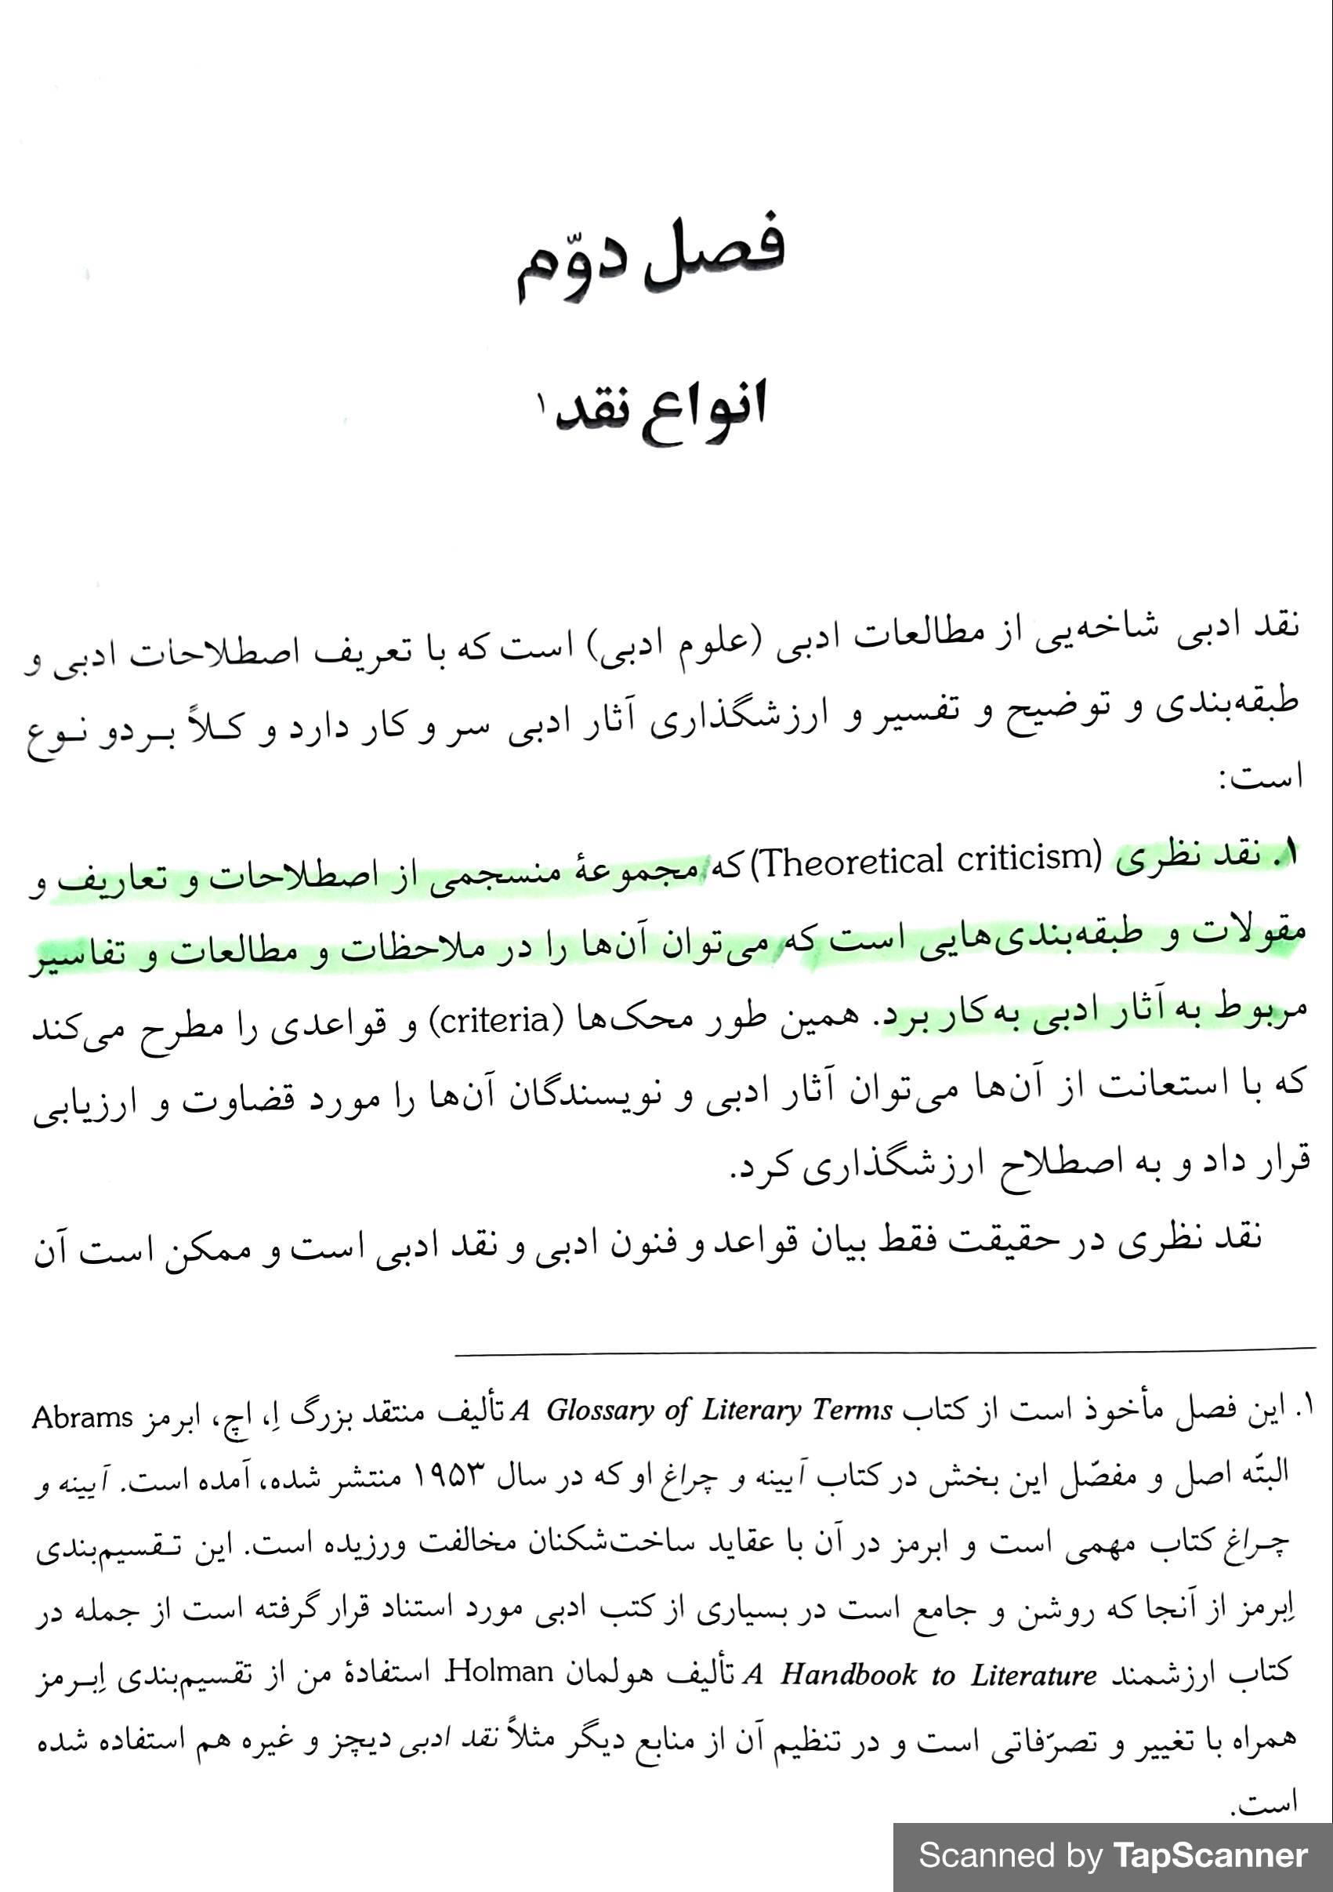

Slide 4
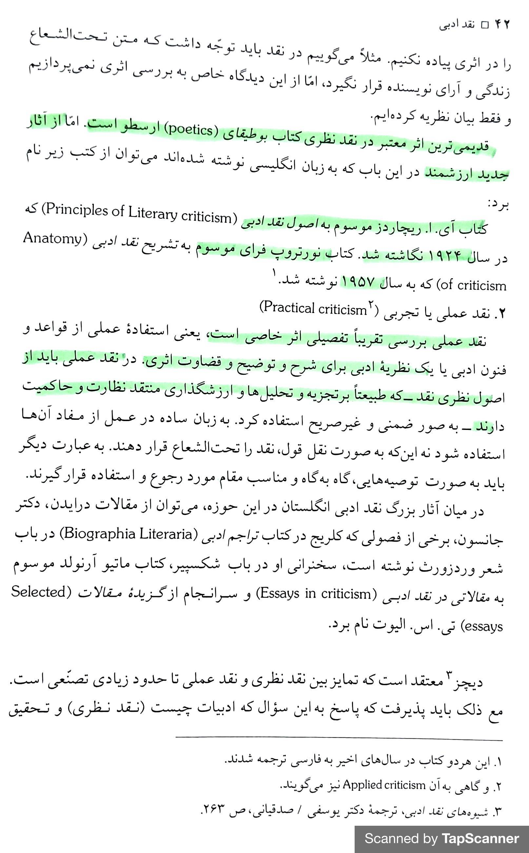

Slide 5
